Slide 1
1
Modelling Multi Serever Queues
(Semi-Markovian
Queueing Systems)
Lecture 9
Communication Theory III
Eng. (Mrs.) PN Karunanayake
Notes:
1

Slide 2
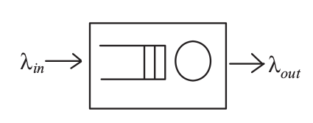
Flow Conservation Law
For a stable queueing system, the rate of customers entering the system observe for a sufficiently long period of time, λ_{out} = λ_{in}
Example:A PBX was installed to handle the voice traffic generated by 300 employees in a factory. If each employee, on average, makes 1.5 calls per hour with an average call duration of 2.5 minutes, what is the offered load presented to this PBX?
2
Notes:
2

Slide 3
M/M/1 Queue
At a neighhourhood polyclinic, patients arrive according to a Poisson process with an average inter-arrival time of 18 minutes. These patients are given a queue number upon arrival and will be seen, by the only doctor manning the clinic, according to their queue number. The length of a typical consultation session is found from historical data to be exponentially distributed with a mean of 7 minutes:
(i) What is the probability that a patient has to wait to see the doctor?
(ii) What is the average number of patients waiting to see the doctor?
(iii) What is the probability that there are more than 5 patients in the clinic,
including the one in consultation with the doctor?
(iv) What is the probability that a patient would have to wait more than 10 minutes for this consultation?
3
Notes:
3

Slide 4
M/M/1/k Queue
Variable-length packets arrive at a network switching node at an average rate of 125 packets per second. If the packet lengths are exponentially distributed with a mean of 88 bits and the single outgoing link is operating at 19.2 kb/s,
(i) what is the probability of buffer overflow if the buffer is only big enough to hold 11 packets?
(ii) On average, how many packets are there in the buffer?
(iii) How big should the buffer be in terms of number of packets to keep packet loss below 10⁻⁶
4
Notes:
4

Slide 5
M/M/m Queue
5
A trading company is installing a new 300-line PBX to replace its old existing over-crowded one. The new PBX will have a group of two-way external circuits and the outgoing and incoming calls will be split equally among them.
It has been observed from past experience that each internal telephone usually generated (call or receive) 20 minutes of voice traffi c during a typical busy day. How many external circuits are required to ensure a blocking probability of 0.02?
assume that the busy hour traffi c level constitutes about 14% of a busy day’s traffic.
Notes:
5

Slide 6
Semi-Markovian Queueing Systems
6
In Markovian queueing systems, both the arrival and service processes are memoryless. These models are appropriate in certain applications such as voice communication.
In the case of packet switching, packets are transmitted either with a fixed length or a certain limit imposed by the physical constraints.
In the latter case, a more appropriate model would be the M/G/1, which belongs to the class of queueing systems called semi-Markovian queueing systems.
Notes:
6

Slide 7
Semi-Markovian Queueing Systems
7
Semi-Markovian queueing systems refer to those queueing systems in which either the arrival or service process is not ‘memoryless’.
Include M/G/1, G/M/1, their priority queueing variants and, of course, the multi-server counterparts.
In M/G/1, the service time already received by the customer in service at time t is specified in addition to the N(t).
This is necessary as the distribution of the remaining service time for that customer under service is no longer the same as the original distribution.
The process N(t) no longer possesses the ‘memoryless’ property.
Notes:
7
In a Markovian queueing system, the stochastic process {N(t), t ≥ 0}, that is the number of customers in the system at time t, summarizes the complete
past history of the system and can be modelled as a birth-death process.
This enables us to write down the balance equations from its state transition diagram,
and then proceed to calculate P k and its performance measures.

Slide 8
General Service, Single Server (M/G/1)
8
Poisson input with mean λ
A general single server with a service distribution time X(t) (and the density function x(t)).
Assume the mean E(x) and the second moment E(x²) of the service time distribution exist and are finite.
Customers are served FCFS.
The capacity of the waiting queue is as usual infinite.
Assume that the service times are independent of the arrival process as well as the number of customers in the system.
The transition probabilities dependent of t.It depends on how long the system has been in the current state.
Notes:
8

Slide 9
9
In a Markovian queueing system, the stochastic process {N(t), t ≥ 0}, (the number of customers in the system at time t), summarizes the complete past history of the system and can be modelled as a birth-death process.
This allows to draw the state transition diagram, and then proceed to calculate P_{k} and its performance measures.
Notes:
9

Slide 10
10
In the case of a semi-Markovian system, M/G/1, it is require to specify the service time already received by the customer in service at time t in addition to the N(t).
This is necessary as the distribution of the remaining service time for that customer under service is no longer the same as the original distribution.
Notes:
10

Slide 11
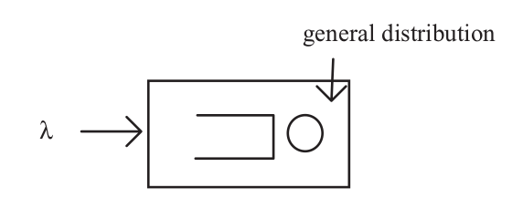
The M/G/1 Queueing System
11
Customers arrive according to a Poisson process with mean λ and are served by a single server of general service-time distribution X(t) (and density function x(t)).
Also assumption is made that the mean E(x) and the second moment E(x² ) of the service time distribution exist and are finite. We denote them as x̄ and x² , respectively.
The capacity of the waiting queue is as usual infinite and customers are served in the order they arrived.
Notes:
11

Slide 12

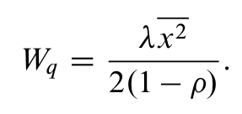
Performance Measures of M/G/1
The expected number of arrivals during a single service period
X – service time
λ – mean arrival
The mean queueing time
12
Notes:
12

Slide 13
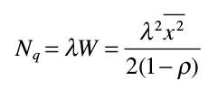
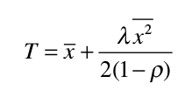
Performance Measures of M/G/1
The number of customers in the waiting queue:
The number of customers in the waiting queue:
13
Notes:
13

Slide 14

The number of customers in the waiting queue:
14
Notes:
14

Slide 15

M/D/1: deterministic service times
The M/D/1 model is a special case of the M/G/1 model where service times are fixed or deterministic and hence the “D” in the notation of M/D/1.
Example: the server is a robot working on some task in an assembly line.
15
Notes:
15

Slide 16

16
Notes:
16

